Slide 1
My Perimeter, Area and Volume Interactive Notebook
Name
Class
Term 3 Semester 2

Slide 2
Contents
Formula Page
Page
Date
Description
2
3

Slide 3
Tasks
24
7
30
Essential Question
Questions
Notes
Summary

Slide 4
24
7
30
Date
Cubes and Rectangular Prisms
EQ – How is a net of a 3-D shape used to find the surface area and volume of a rectangular prism?

Slide 5
24
7
30
Date
Cubes and Rectangular Prisms
EQ – How is a net of a 3-D shape used to find the surface area and volume of a rectangular prism?
A net is a 2-D picture that folds to make a 3-D shape.

Slide 6
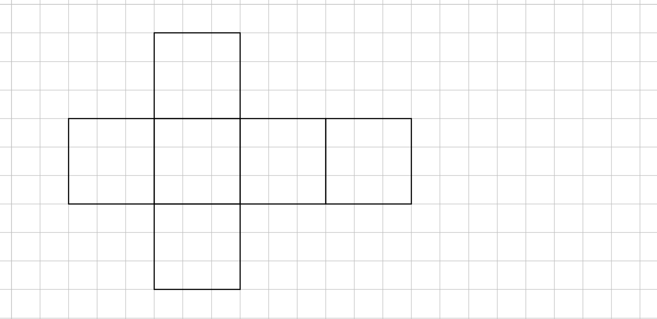
24
7
30
Date
Cubes and Rectangular Prisms
EQ – How is a net of a 3-D shape used to find the surface area and volume of a rectangular prism?
A net is a 2-D picture that folds to make a 3-D shape.
Activity – cut out the net of the cube

Slide 7
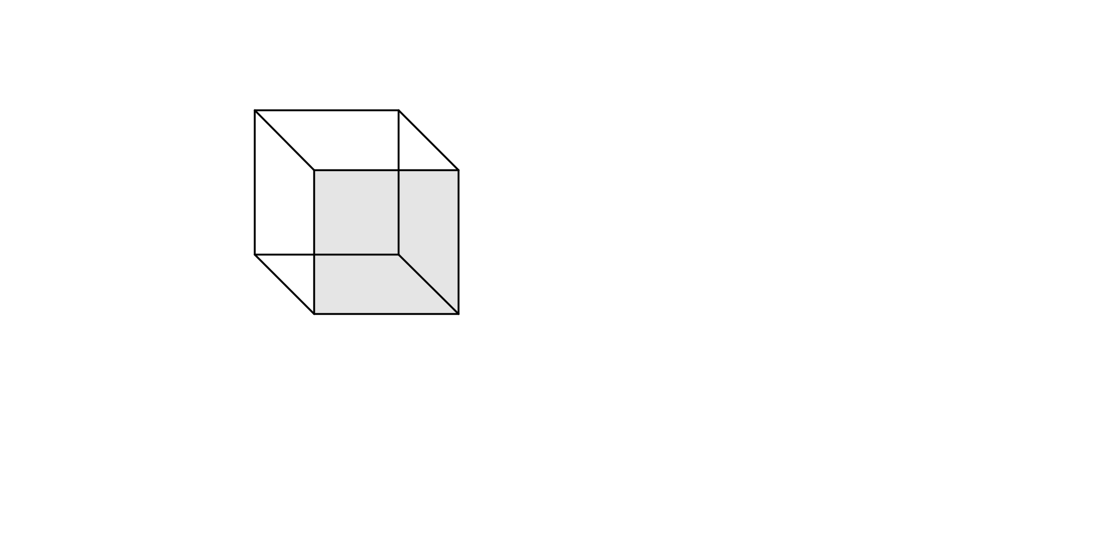
24
7
30
Date
Cubes and Rectangular Prisms
EQ – How is a net of a 3-D shape used to find the surface area and volume of a rectangular prism?
19

Slide 8
24
7
30
Date
Cubes and Rectangular Prisms
EQ – How is a net of a 3-D shape used to find the surface area and volume of a rectangular prism?
A net is a 2-D picture that folds to make a 3-D shape.
19

Slide 9
24
7
30
Date
Cubes and Rectangular Prisms
EQ – How is a net of a 3-D shape used to find the surface area and volume of a rectangular prism?
A net is a 2-D picture that folds to make a 3-D shape.
Edge
Vertex
(corner)
Face
19

Slide 10
24
7
30
Date
Cubes and Rectangular Prisms
EQ – How is a net of a 3-D shape used to find the surface area and volume of a rectangular prism?
A net is a 2-D picture that folds to make a 3-D shape.
Edge
Vertex
(corner)
Face
To find the surface area you add together the areas of all the faces
The volume describes how much space the object occupies
19

Slide 11
Task
1. Fill in the following-
A cube has
___ faces,
___ edges and
___ vertices.
2. Find the area of each face.
3. Find the total surface area for the cube
4. Find the volume for the cube

Slide 12
Task
1. Fill in the following-
A cube has
6 faces,
12 edges and
8 vertices.
2. Find the area of each face.
3. Find the total surface area for the cube
4. Find the volume for the cube

Slide 13
Task
1. Fill in the following-
A cube has
6 faces,
12 edges and
8 vertices.
2. Find the area of each face.
3. Find the total surface area for the cube
4. Find the volume for the cube
3x3=9
3x3=9
3x3=9
3x3=9
3x3=9
3x3=9

Slide 14
Task
1. Fill in the following-
A cube has
6 faces,
12 edges and
8 vertices.
2. Find the area of each face.
3. Find the total surface area for the cube
6 x 9 = 54cm²
4. Find the volume for the cube
3x3=9
3x3=9
3x3=9
3x3=9
3x3=9
3x3=9

Slide 15
Task
1. Fill in the following-
A cube has
6 faces,
12 edges and
8 vertices.
2. Find the area of each face.
3. Find the total surface area for the cube
6 x 9 = 54cm²
4. Find the volume for the cube
3x3x3=3³=27cm³
3x3=9
3x3=9
3x3=9
3x3=9
3x3=9
3x3=9

Slide 16


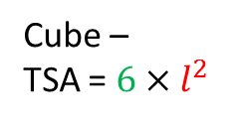
24
7
30
Date
Cubes and Rectangular Prisms
EQ – How is a net of a 3-D shape used to find the surface area and volume of a rectangular prism?
$$l$$
To find the surface area you add together the areas of all the faces
TSA is Total Surface Area
Cube –
TSA = $6×l^{2}$
Number of faces x
Area of each face
Volume = $l^{3}$
19

Slide 17
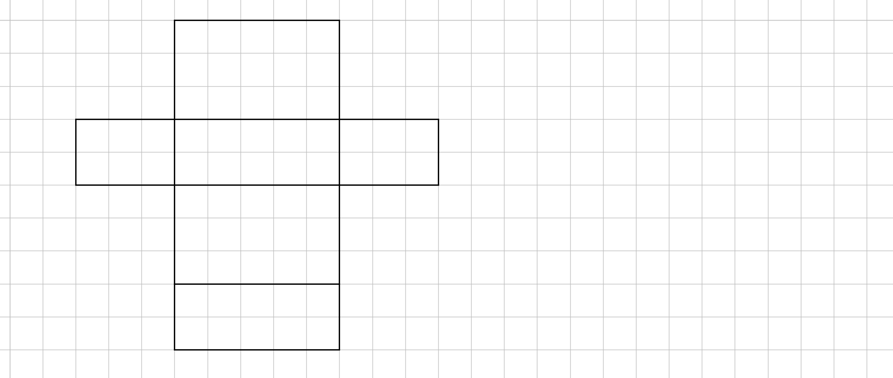
Task
1. Fill in the following-
A rectangular prism has
___ faces,
___ edges and
___ vertices.
2. Find the area of each face.
3. Find the total surface area for the rectangular prism.
4. Find the volume for the rectangular prism

Slide 18
Task
1. Fill in the following-
A rectangular prism has
6 faces,
12 edges and
8 vertices.
2. Find the area of each face.
3. Find the total surface area for the rectangular prism.
4. Find the volume for the rectangular prism

Slide 19
Task
1. Fill in the following-
A rectangular prism has
6 faces,
12 edges and
8 vertices.
2. Find the area of each face.
3. Find the total surface area for the rectangular prism.
4. Find the volume for the rectangular prism
5 x 3 = 15
5 x 3 = 15

Slide 20
Task
1. Fill in the following-
A rectangular prism has
6 faces,
12 edges and
8 vertices.
2. Find the area of each face.
3. Find the total surface area for the rectangular prism.
4. Find the volume for the rectangular prism
5 x 3 = 15
5 x 2 = 10
5 x 3 = 15
5 x 2 = 10

Slide 21
Task
1. Fill in the following-
A rectangular prism has
6 faces,
12 edges and
8 vertices.
2. Find the area of each face.
3. Find the total surface area for the rectangular prism.
2 x 15
4. Find the volume for the rectangular prism
5 x 3 = 15
2 x 3 = 6
5 x 2 = 10
2 x 3 = 6
5 x 3 = 15
5 x 2 = 10

Slide 22
Task
1. Fill in the following-
A rectangular prism has
6 faces,
12 edges and
8 vertices.
2. Find the area of each face.
3. Find the total surface area for the rectangular prism.
2 x 15 + 2 x 10
4. Find the volume for the rectangular prism
5 x 3 = 15
2 x 3 = 6
5 x 2 = 10
2 x 3 = 6
5 x 3 = 15
5 x 2 = 10

Slide 23
Task
1. Fill in the following-
A rectangular prism has
6 faces,
12 edges and
8 vertices.
2. Find the area of each face.
3. Find the total surface area for the rectangular prism.
2 x 15 + 2 x 10 + 2 x 6
4. Find the volume for the rectangular prism
5 x 3 = 15
2 x 3 = 6
5 x 2 = 10
2 x 3 = 6
5 x 3 = 15
5 x 2 = 10

Slide 24
Task
1. Fill in the following-
A rectangular prism has
6 faces,
12 edges and
8 vertices.
2. Find the area of each face.
3. Find the total surface area for the rectangular prism.
2 x 15 + 2 x 10 + 2 x 6 = 62cm²
4. Find the volume for the rectangular prism
5 x 3 = 15
2 x 3 = 6
5 x 2 = 10
2 x 3 = 6
5 x 3 = 15
5 x 2 = 10

Slide 25



Task
1. Fill in the following-
A rectangular prism has
6 faces,
12 edges and
8 vertices.
2. Find the area of each face.
3. Find the total surface area for the rectangular prism.
2 x 15 + 2 x 10 + 2 x 6 = 62cm²
4. Find the volume for the rectangular prism
5 x 3 x 2 = 30cm³
5 x 3 = 15
2 x 3 = 6
5 x 2 = 10
2 x 3 = 6
5 x 3 = 15
5 x 2 = 10
$$2$$
$$3$$
$$5$$

Slide 26
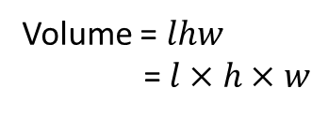
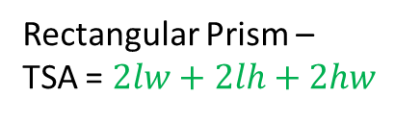



24
7
30
Date
Cubes and Rectangular Prisms
EQ – How is a net of a 3-D shape used to find the surface area and volume of a rectangular prism?
$$h$$
$$w$$
$$l$$
To find the surface area you add together the areas of all the faces
TSA is Total Surface Area
Rectangular Prism –
TSA = $2lw+2lh+2hw$
2 x each size rectangle
Volume = $lhw$
= $l×h×w$
19

Slide 27
Questions

Slide 28
24
7
30
Date
Cubes and Rectangular Prisms
EQ – How is a net of a 3-D shape used to find the surface area and volume of a rectangular prism?
What is a net?
A net is a 2-D picture that folds to make a 3-D shape.
What are the part s of a 3-D shape called?
Edge
Vertex
Face
19

Slide 29
24
7
30
Date
Cubes and Rectangular Prisms
EQ – How is a net of a 3-D shape used to find the surface area and volume of a rectangular prism?
How do you find the TSA and volume of a cube?
$$l$$
To find the surface area you add together the areas of all the faces
TSA is Total Surface Area
Cube –
TSA = $6×l^{2}$
Number of faces x
Area of each face
Volume = $l^{3}$
19

Slide 30
24
7
30
Date
Cubes and Rectangular Prisms
EQ – How is a net of a 3-D shape used to find the surface area and volume of a rectangular prism?
How do you find the TSA and volume of a rectangular prism?
$$h$$
$$w$$
$$l$$
To find the surface area you add together the areas of all the faces
TSA is Total Surface Area
Rectangular Prism –
TSA = $2lw+2lh+2hw$
2 x each size rectangle
Volume = $lhw$
= $l×h×w$
19

Slide 31
Notes Review
24, 7 ,30
Date
Title
Essential question
Notes complete
Notes complete with colour and diagrams
Questions completed
Contents page filed in
Formula page filled in

Slide 32
Homework
Review your notes and write a summary answering the essential question.

